Slide 1
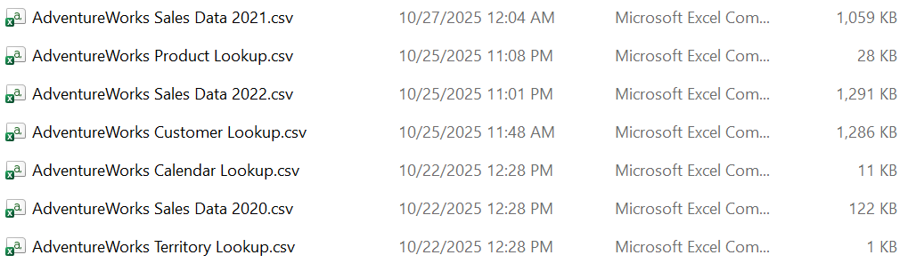
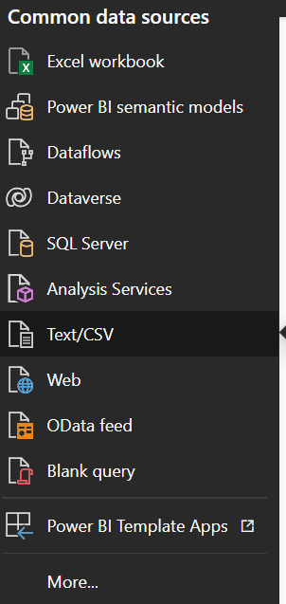
Import Data
Check the data format
Data format is csv, so select text/csv to import

Slide 2
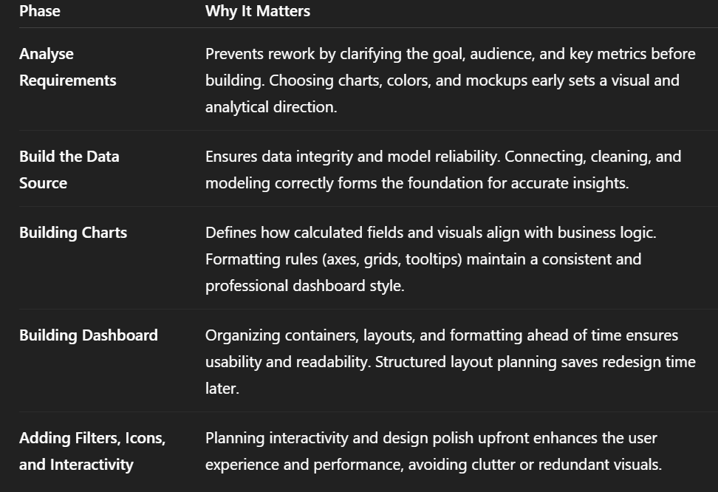
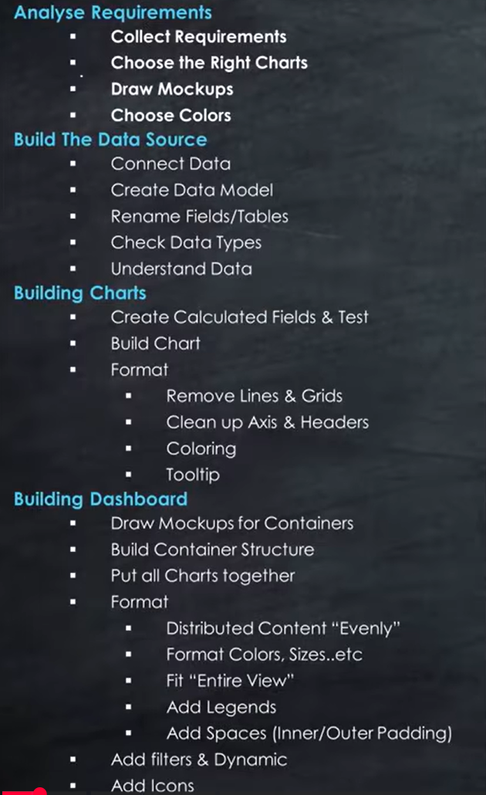
Create Project Roadmap

Slide 3
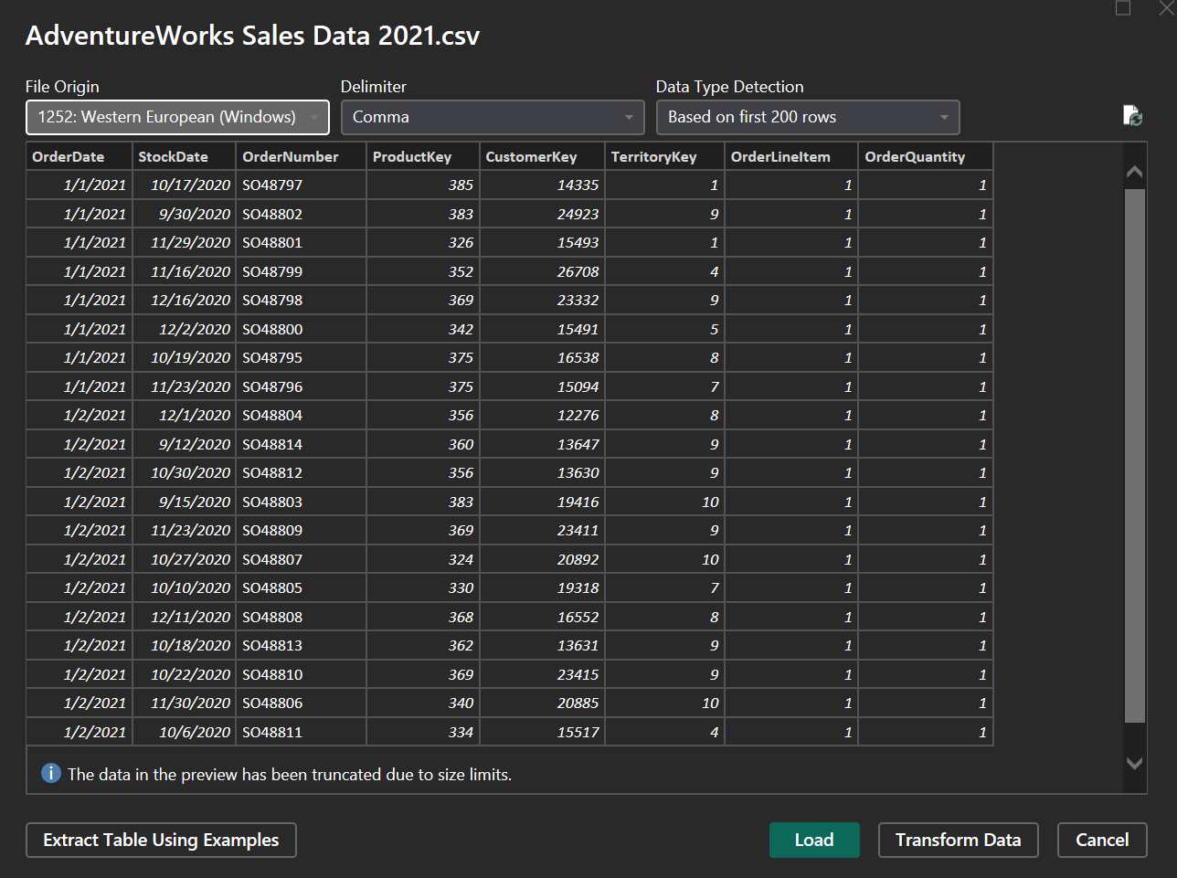
Load Data Interface
Select load data to import

Slide 4
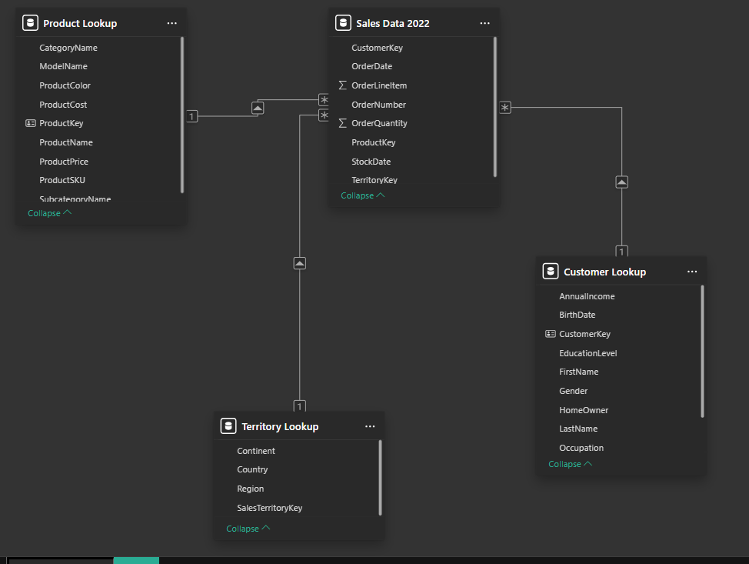
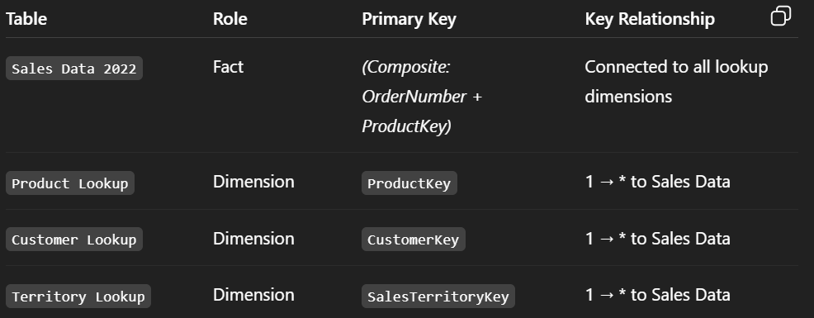
Establishing Table Relationships
At this stage, the data model was constructed following a star schema structure.
Fact table: Sales Data 2022
Dimension tables: Product Lookup, Customer Lookup, and Territory Lookup
The goal of this design is to centralize transaction-level data in the fact table, while using lookup (dimension) tables to provide descriptive attributes for filtering, slicing, and aggregation.
Cross filter direction for all table is single.

Slide 5
Create Calendar Lookup Table
Calendar Lookup =
VAR _MinYear =
-- Get the earliest year in the dataset
-- Using StockDate because inventory typically starts before sales
YEAR( MIN( 'Sales Data 2022'[StockDate] ) )
VAR _MaxYear =
-- Get the latest year in the dataset
-- Using OrderDate because sales activity usually extends further than stock
YEAR( MAX( 'Sales Data 2022'[OrderDate] ) )
RETURN
-- Generate a continuous list of daily dates
-- The calendar starts from January 1st of the earliest year
-- and ends on December 31st of the latest year
CALENDAR(
DATE( _MinYear, 1, 1 ),
DATE( _MaxYear, 12, 31 )
)
Purpose:
Generates a Calendar (Date Dimension) used to support time-based reporting, trend analysis, and time-intelligence DAX functions.
Why MIN(StockDate) for the start:
  StockDate indicates when items first became available for sale.
  Inventory events typically occur earlier than customer orders.
  Ensures that the calendar includes all relevant pre-sales activities such as stock-in or product availability.
Why MAX(OrderDate) for the end:
  OrderDate represents actual transaction timing.
  It usually extends further than StockDate because orders continue after inventory is stocked.
  Ensures that all sales transactions up to the latest record are included.
Result:
The calendar range fully covers the business timeline — from the earliest inventory record to the latest sale — preventing missing or truncated periods in visual filters or time intelligence functions.

Slide 6
Create Time-intelligence columns
These columns turn the basic date list into a full time dimension that supports consistent, sortable, and readable daily, monthly, quarterly, and yearly analysis across all visuals and DAX measures.
EOY =
ENDOFYEAR( 'Calendar Lookup'[Date] )
Year =
YEAR( 'Calendar Lookup'[Date] )
EOM (text) =
ENDOFMONTH( 'Calendar Lookup'[Date] )
Month (text) =
FORMAT(
[Date],
"mmm"
)
EOM (number) =
ENDOFMONTH( 'Calendar Lookup'[Date] )
Month (number) =
MONTH( [Date] )
EOQ =
ENDOFQUARTER( 'Calendar Lookup'[Date] )
Day =
DAY( [Date] )

Slide 7
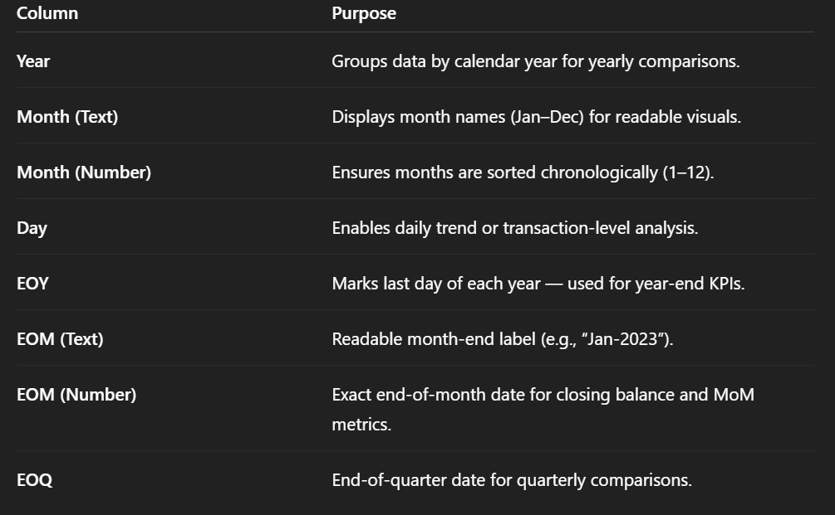
Explain Time-intelligence columns

Slide 8
Analyze Requirement
Introduction
The goal is to build two dashboards to help Sales Managers and Executives analyze sales performance and customer insights effectively.
Dashboard Requirements
Dashboard Purpose
Provide a clear overview of sales performance across time and customer groups.
Support decision-making by showing trends, comparisons, and granular insights such as YoY and MoM growth
Trend Analysis
Present key sales metrics: Units Sold, Revenue, and Profit.
Compare YoY, MoM performance to track growth or decline.
Highlight highest and lowest months to help users identify peaks and dips easily.
Comparative Analysis
Allow quick comparison of performance by region.
Identify which customer segments (demographics) have the highest or lowest sales metrics.
Compare product-level performance across the portfolio.
Granularity
Support multi-level drill-down for deeper trend analysis.
Design & Interaction
Include filters and slicers to let users interact with different product categories or regions.
Ensure visuals support drill-down analysis for detailed insights.

Slide 9
Overview Dashboard
Filter
Overview Dashboard
Navigation
Unit Sold
Revenue
Profit
Display the total Unit Sold of the current year.
Display the YoY change as KPI’s detail. Format increase with green, decrease with red
Display the revenue of the current year
Display the YoY change as KPI’s detail. Format increase with green, decrease with red
Display the total of profit the current year.
Display the YoY change as KPI’s detail. Format increase with green, decrease with red
Show 12-month trend by column chart. Dark color for above-average, grey for below-average
Show 12-month trend by column chart. Dark color for above-average, grey for below-average
Show 12-month trend by column chart. Dark color for above-average, grey for below-average
Column chart shows top 5 highest or lowest
Column chart shows top 5 highest or lowest
Column chart shows top 5 highest or lowest

Slide 10
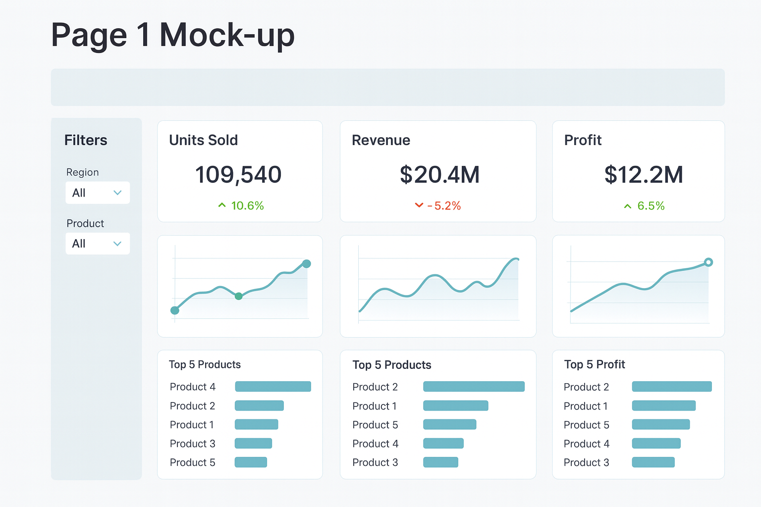
Mock-up

Slide 11
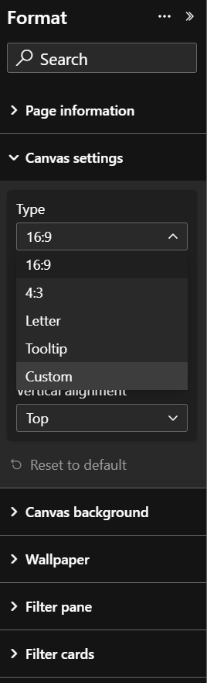
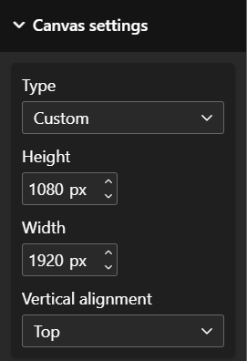
Set up Canvas Size
Change Canvas size to 1920 x 1080

Slide 12
Calculate Needed Columns
Unit Sold
= Sum of all quantities sold
Revenue
= Quantity × Price
Profit
= (Price − Cost) × Quantity
Need to create calculated columns to calculate these metrics.
Go to Table View, > Sales table > Column tool > New Column. You need to calculate Revenue and Profit column.
Revenue =
'Sales Data 2022'[OrderQuantity] * 'Sales Data 2022'[Price]
Profit =
( 'Sales Data 2022'[Price] - 'Sales Data 2022'[Cost] ) * 'Sales Data 2022'[OrderQuantity]
Firstly, you have to relate the Price column from Product table to Sales table.
Function:
RELATED(ColumnName)
Returns a related value from another table.
Price =
RELATED( 'Product Lookup'[ProductPrice] )
Cost =
RELATED( 'Product Lookup'[ProductCost] )

Slide 13
Calculate Needed Measures
In table tools > New Table > Name WorkingMeasure
WorkingMeasure =
Select new measure to create needed measures.
1. Unit Sold =
SUM ( 'Sales Data 2022'[OrderQuantity] )
2. Revenue =
SUM( 'Sales Data 2022'[Revenue] )
3. Profit =
SUM( 'Sales Data 2022'[Profit] )

Slide 14
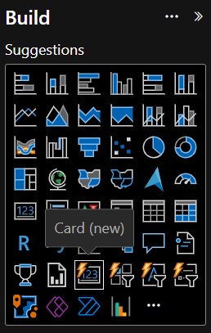
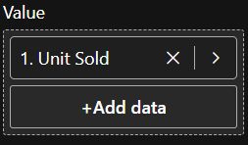
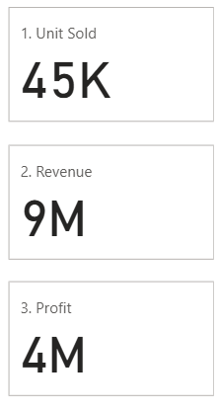
Build KPI Card (1)
Use Card (New)
Build Unit Sold Card > All measures into Value field
Output may look like this

Slide 15
Build KPI Card (2)
Besides the total of a metric, you also want to know its YoY fluctuations. Create the flowing measures to calculate the YoY change. Then change data format to percentage.
2.1 Revenue YoY % = -- Define current year total
VAR _Current = [2. Revenue]
-- Define previous year total
VAR _Previous =
CALCULATE(
[2. Revenue],
-- Set a condition that calculate the previous year total
DATEADD('Calendar Lookup'[Date], -1, YEAR)
)
RETURN
DIVIDE(_Current - _Previous, _Previous)
1.1 Unit Sold YoY % = -- Define current year total
VAR _Current = [1. Unit Sold]
-- Define previous year total
VAR _Previous =
CALCULATE(
[1. Unit Sold],
-- Set a condition that calculate the previous year total
DATEADD('Calendar Lookup'[Date], -1, YEAR)
)
RETURN
DIVIDE(_Current - _Previous, _Previous)
3.1. Profit YoY % = -- Define current year total
VAR _Current = [3. Profit]
-- Define previous year total
VAR _Previous =
CALCULATE(
[3. Profit],
-- Set a condition that calculate the previous year total
DATEADD('Calendar Lookup'[Date], -1, YEAR)
)
RETURN
DIVIDE(_Current - _Previous, _Previous)

Slide 16
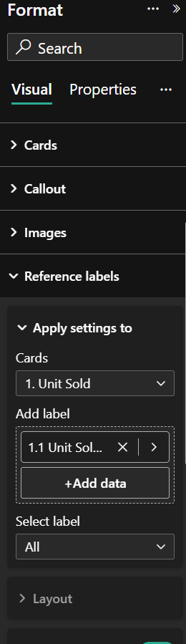
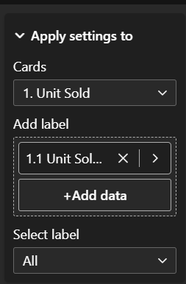
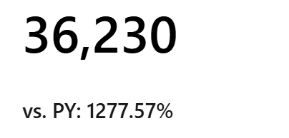
Build KPI Card (3)
Open format pane of the card, go to Reference Label, drop the YoY measure to each card. Then select the current YoY measure

Slide 17
Build KPI Card (3)
Besides the total of a metric, you also want to know its MoM fluctuations. Create the flowing measures to calculate the MoM change. Then change data format to percentage.
2.2 Revenue MoM % =
VAR _CurrentMonth = [2. Revenue]
VAR _PreviousMonth =
CALCULATE(
[2. Revenue],
DATEADD('Calendar Lookup'[Date], -1, MONTH)
)
RETURN
DIVIDE(_CurrentMonth - _PreviousMonth, _PreviousMonth)
1.2 Unit Sold MoM % =
-- Define current month total
VAR _CurrentMonth = [1. Unit Sold]
-- Define previous month total
VAR _PreviousMonth =
CALCULATE(
[1. Unit Sold],
-- Set a condition that calculate the previous month total
DATEADD('Calendar Lookup'[Date], -1, MONTH)
)
RETURN
DIVIDE(_CurrentMonth - _PreviousMonth, _PreviousMonth)
3.2 Profit MoM % =
VAR _CurrentMonth = [3. Profit]
VAR _PreviousMonth =
CALCULATE(
[3. Profit],
DATEADD('Calendar Lookup'[Date], -1, MONTH)
)
RETURN
DIVIDE(_CurrentMonth - _PreviousMonth, _PreviousMonth)

Slide 18
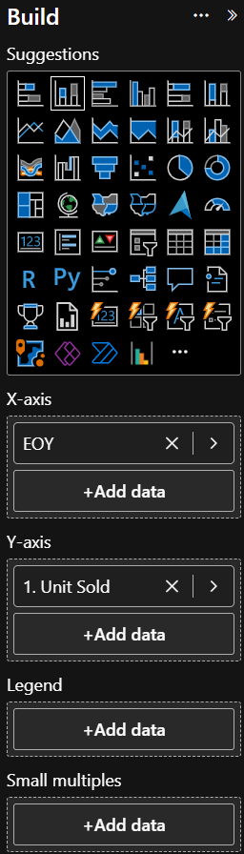
Build KPI Card (3)
You want the user to know the growth over years, so a column chart of each metric by year is placed beside the kpi card.
Output may look like this.

Slide 19
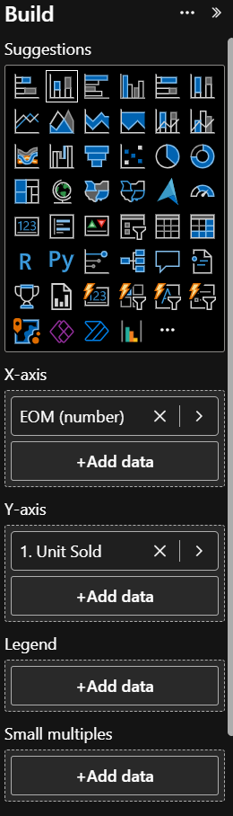
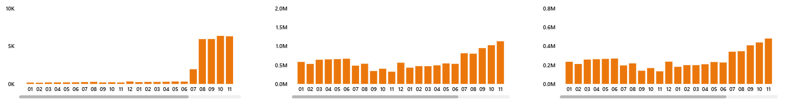
Build Column Chart Showing Trend
You want to view the trend and also the magnitude of differences between month. Therefore, column chart is the best graph for this use case.
Drop EOM (number) into X-axis and 1. Unit Sold into Y-axis. Apply the same steps to other metrics. The final output should look like this

Slide 20
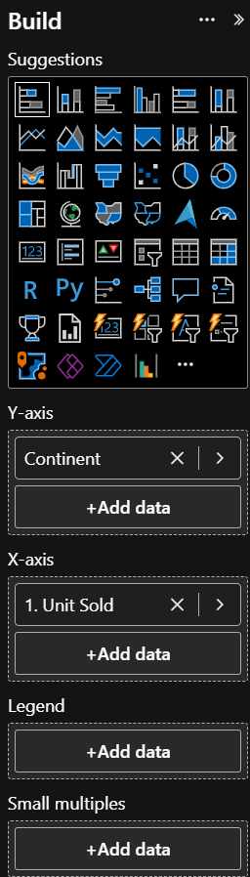
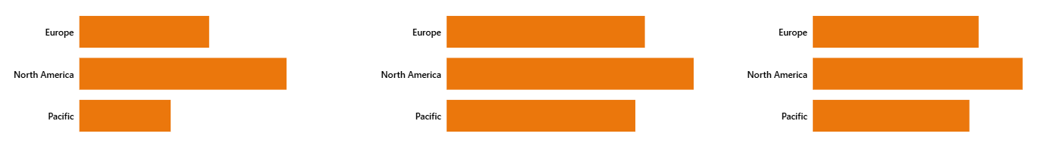
Build Comparison Bar Chart
You want to compare the metrics across different regions, countries, products. Bar chart is the best for this use case. Use Continent is Territory Lookup table for Y-axis and Unit Sold for X-axis. Do the same steps for other metrics and the output should look like this.

Slide 21
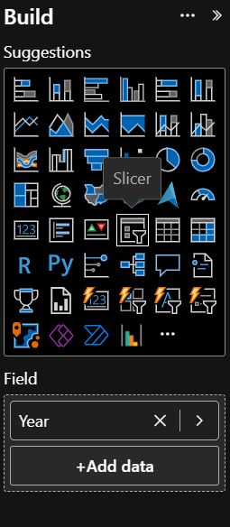
Build Filter Pane
Create slicer to filter the data. This is report, you allow users to select year, month, continent, region and product category. Your output may look like this. -
Ctrl + Click to each slicer to select all of them, go to format pane > slicer setting > style > drop down. The output should look like this.

Slide 22
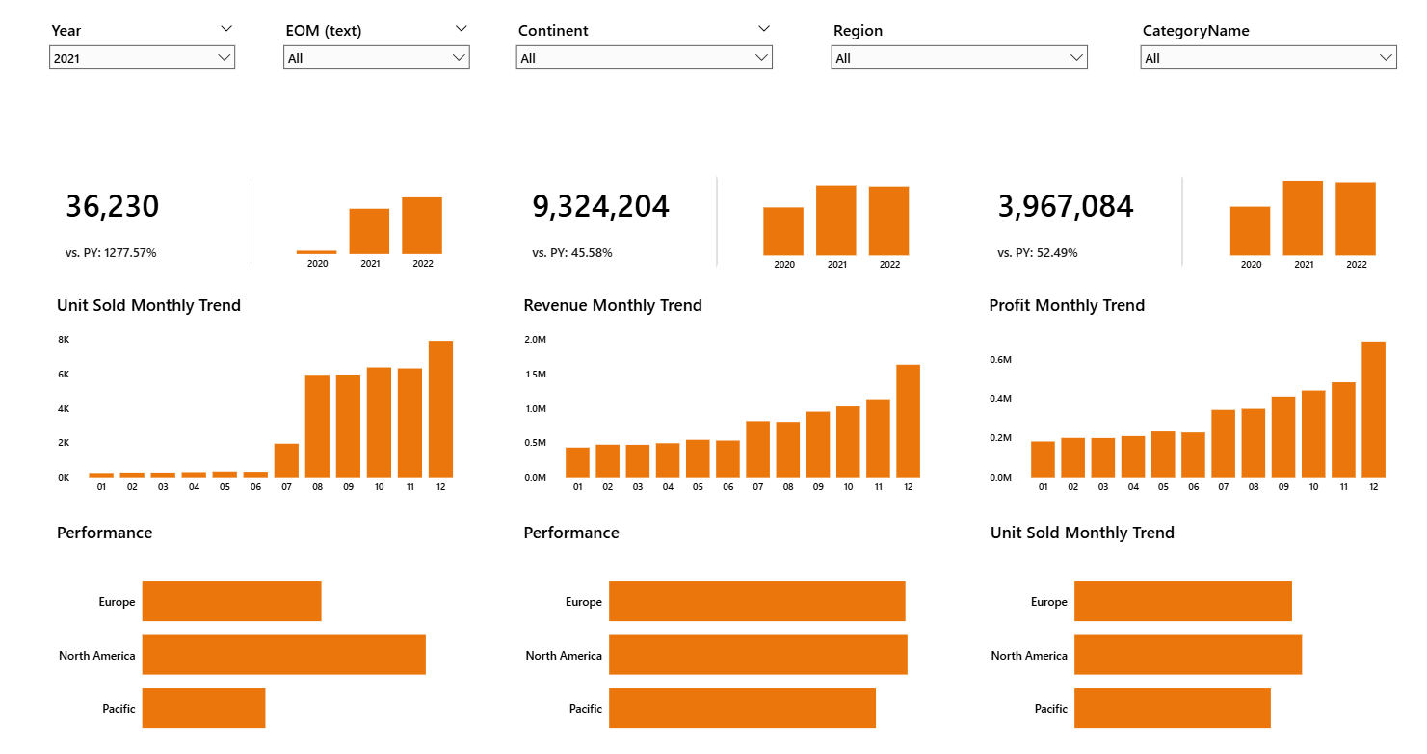
The First Draft Output

Slide 23
Overview Dashboard
Unit Sold
Revenue
#112755
Profit

Slide 24
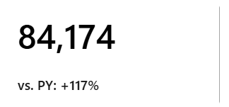
Format the KPI Cards (1)
Select all cards > Format pane > Callout > Change all settings to All > Turn off label
Select all cards > Format pane > Reference Label > Apply setting to All > Turn off background > Divider > Change to White Color
Select each card > Callout > Apply setting to primary metric > Display Units > Select None
Select each card > Properties > Apply setting to primary metric > Whole Number in Format Pane > Turn on Thousand Separator
Select the YoY measure in the Data tab on the right hand side > Format > Dynamic > Paste this in to the box "0.00% ▲;-0.00% ▼;0.00% ▲“. Repeat with other measure

Slide 25
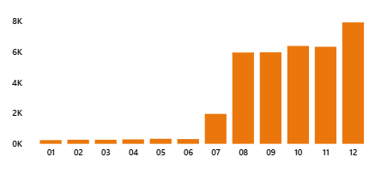
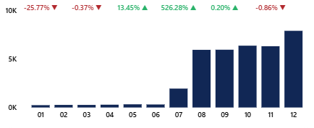
Format Column Chart
The column chart is decent but now we want the use to spot the MOM change immediately. We will build some measure to achieve this desire.

Slide 26
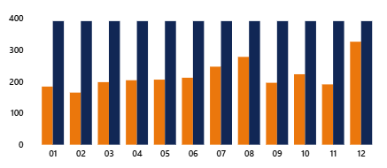
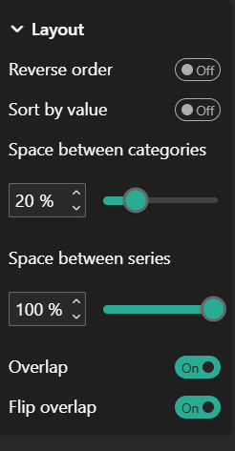
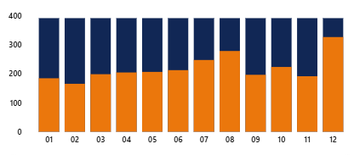
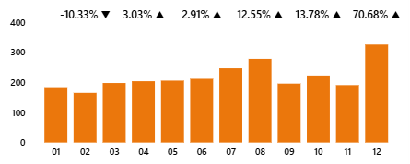
Format Column Chart
Create a measure to make the MoM float above the column. Copy the measure below.
Change the current column chart to Cluster column chart and drop the new measure to the visual. Do not remove current measure. (Figure 1)
Format pane > Column > Layout > Try to have this format> (Fig 2) >Outlook like this (Fig 3)
Column > Select the format measure > Change color to white to make the format measure transparent
Date label > Unit Sold > Turn on Value > Formatting measure > Turn off Value > Turn on Detail > Add Unit Sold MoM to Detail > Do some formatting to adjust size (Fig 4)
Create formatting measure for Revenue and Profit and repeat all above steps
1.4. Upper Bound Time Series =
VAR _Max =
MAXX(
ALLSELECTED( 'Calendar Lookup'[EOM (number)] ),
[1. Unit Sold]
)
RETURN
_Max + _Max*0.2

Slide 27
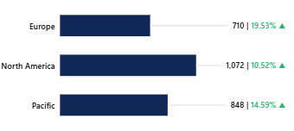
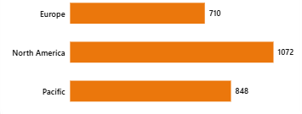
Format Comparison Bar Chart
The original bar chart is also decent but it need some formatting to align the data label and signal the MoM change for the users

Slide 28
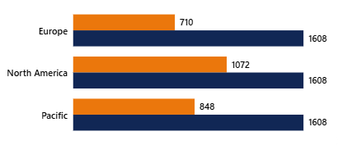
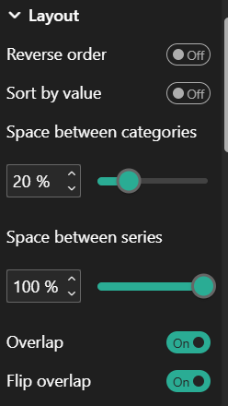
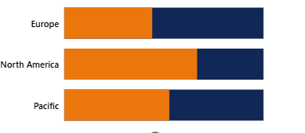
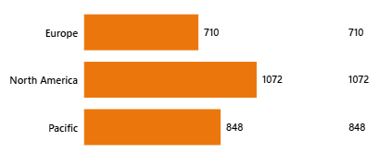
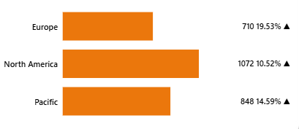
Format Bar Chart
Click “…” button on the visual > Select Visual Calculation > Custom > Paste the DAX below to create the white space similar to the case of the above column chart.
Change the current bar chart to Cluster bar chart. Do not remove current measure. (Figure 1)
Format pane > Column > Layout > Try to have this format> (Fig 2) >Outlook like this (Fig 3)
Column > Select the Max measure > Change color to white to make the bar transparent
Date label > Unit Sold > Turn on Value > Max measure > Value > Click the data field > change to Unit Sold Measure (Fig 4) > Turn on Detail > Add Unit Sold YoY to Detail > Change the position of data label from Auto to Outside end
Formatting measure > Value > Display unit to Custom > “#,## |” to separate the Value and the MoM (Fig 5)
Create formatting measure for Revenue and Profit and repeat all above steps
Max = MAXX( ROWS, [1. Unit Sold] ) * 1.5

Slide 29
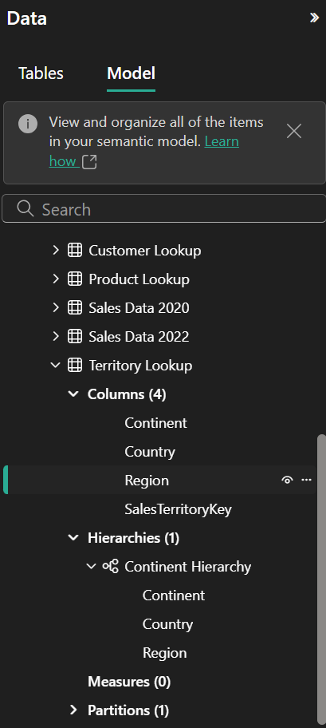
Format Bar Chart
Now you want the users can drill down the bar chart and to different dimensions and can switch between categories such as geography, product types …
Create visual hierarchy to allow drill down
Model view> Model Tab > Territory Lookup > right click Continent > Create hierarchy > Now you see Continent appear in Hierarchies > Click and drop Country then Region to hierarchies section
Create product hierarchy > Do the same with CategoryName, SubcategoryName, ModelName, ProductName
Now you want to switch between these 2 Cateogry Hierarchy to explore different dimension but the visual can only show one hierarchy at a time.
Create parameter to allow you switch between fields. However, parameter does not allow you to add hierarchy in it, so you have to do some adjustment after creating parameter
Report View > Modelling > New Parameter > Fields > Add category one by one follow the order of hierarchy that I introduce above > Create.
Select the parameter > Fix the DAX copy the one below
Geography and Product = {
("Continent", NAMEOF('Territory Lookup'[Continent]), 0, "Geography"),
("Country", NAMEOF('Territory Lookup'[Country]), 1, "Geography"),
("Region", NAMEOF('Territory Lookup'[Region]), 2, "Geography"),
("CategoryName", NAMEOF('Product Lookup'[CategoryName]), 3, "Product"),
("SubcategoryName", NAMEOF('Product Lookup'[SubcategoryName]), 4, "Product"),
("ModelName", NAMEOF('Product Lookup'[ModelName]), 5, "Product"),
("ProductName", NAMEOF('Product Lookup'[ProductName]), 6, "Product")
}

Slide 30
Format Bar Chart
Now you will replace the current fields in the visual by the parameter.
Select visual > Click the “>” button > Select “Geography and Product”, this the parameter field, which must be use in all visual if you want to use the parameter.
Create a slicer > Drop group in the field and test the interaction with visual, the visual should allow you to drill down.
Change the filter to drop down type, single selection

Slide 31
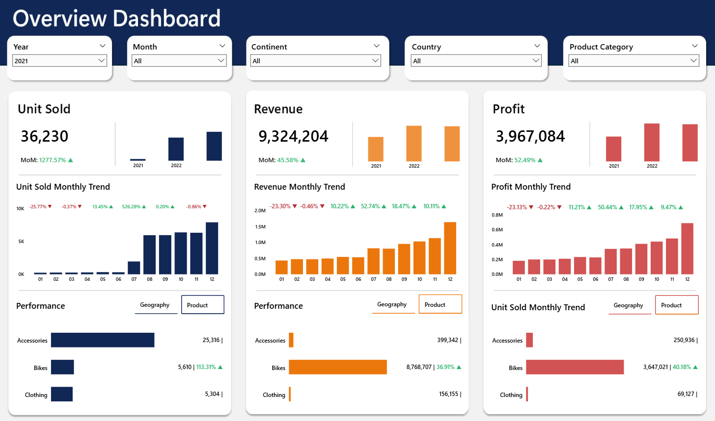
Final Output

